Slide 1
SPLUNK
BASIC ARCHITECTURE & DATA FLOW

Slide 2
C O N T E N T
01
CONCEPTS
05
DATA FLOW SPLUNK
08
SPLUNK PORT
02
06
SPLUNK COMPONENTS
09
SPLUNK BENEFITS
SIEM
03
SIEM TOOLS
07
SPLUNK NETWORK DATA FLOW
04
WHAT IS SPLUNK

Slide 3

SPLUNK CONCEPTS
SIEM
Security Information and Event Management
Splunk’s analytics-driven SIEM goes beyond simple information and event management to tackle real-time security monitoring, advanced threat detection, forensics and incident management. With an analytics-driven SIEM you can build a stronger security posture and improve cross-department collaboration.

Slide 4
BENEFITS OF SIEM
ANOMALY DETECTION
COLLECTORS
ALERTING
6
ADVANCED THREAT DETECTION
EVENTS CORRELATION
4
BIG DATA ANALYSTICS
2
5
1
3

Slide 5
BENEFITS OF SIEM
MAINTAIN CONTINUOUS SECURITY
INCIDENT RESPONSE
DASHBOARDS
COMPLIANCE REPORTING
9
7
10
8

Slide 6




SIEM TOOL
SIEM

Slide 7
WHAT IS SPLUNK?
ANALYZING
VISULIZING
REPORTING
Splunk is a GOOGLE of LOGS. Splunk is a software platform to search, analyze and visualize the machine-generated data gathered from the websites, applications, sensors, devices etc. which make up your IT infrastructure and business.

Slide 8
Data Flow Stages
Input stage
Searching stage
Storage stage
Parsing
Indexing

Slide 9
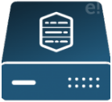



S P L U N K N E T W O R K F L O W
Linux
Window
Universal Forwarder
Cisco
Search Head
Heavy Forwarder
VmWare
Indexer

Slide 10



S P L U N K C O M P O N N E N T
FORWARDER
DEPLOYMENT SERVER
SEARCH HEAD CLUSTER
1
4
7
INDEXER
MASTER CLUSTER NODE
2
5
SEARCH HEAD
LICENSE MASTER
3
6

Slide 11


S P L U N K F O R W A R D E R
Splunk Forwarder is the component which you have to use for collecting the logs from network source and send this logs to indexer.
U.F
H.F
1
2
UNIVERSAL FORWARDER
HEAVY FORWARDER
COLLECT RAW DATA AND SEND INDXER
LIGHT FOOTPRINT
INSTALL DIRECTLY ON SORCE SIDE
FILTER UNWANTED DATA
DO PARSING
HEAVY FOOTPRINT
DID NOT INSTALL ON SOURCE SIDE

Slide 12

S P L U N K I N D E X E R
Indexer is the Splunk component which you will have to use for indexing and storing the data coming from the forwarder.
1
2
3N
INDEXING
PARSINNG
STORE DATA
you can create and specify other indexes for different data inputs. An index is a collection of directories and files
Remove and filter unwanted raw data stream into individual, searchable events
Indexer store data locally in a host machine or on cloud

Slide 13

S P L U N K SEARCH HEAD
Search head is the component used for interacting with Splunk. It provides a graphical user interface to users for performing various operations. You can search and query the data stored in the Indexer by entering search words and you will get the expected result.
S.H
S.H
S.H
S.H
1
2
3
4
SEARCHING
ANALYZING
REPORTING
VISULIZING

Slide 14

S P L U N K DEPLOYMENT SERVER
Deployment server user to deploy the configuration and set of polices for different splunk component from a central location.
D.S
D.S
1
2
DEPLOY CONFIGURATION
TIME EFFECTIVE

Slide 15

S P L U N K MASTER CLUSTER NODE
Group of indexer are called Index Cluster. Master Cluster Node is Control, Deploy configuration and set of Policies of Index Cluster.
1
2
3N
– Peer Node
– Search Factor
– Replication Factor
SPLUNK INDEXER CLUSTERING
BETTER PERFORMANCE

Slide 16
SPLUNK CLUSTER
I.C
S.H.C
1
2
INDEXER CLUSTER
SEARCH HEAD CLUSTER
Group of indexer are called Indexer Cluster
Data Replication.
User created reports/dashboards automatically replicated
to other search heads

Slide 17
SPLUNK PORT
SPLUNK INDEX REPLICATION PORT
SPLUNK WEB PORT
KV STORE
8089
514
9997
8080
8000
8191
SPLUNK MANAGEMENT PORT
SPLUNK NETWORK PORT
SPLUNK INDEXING PORT

Slide 18
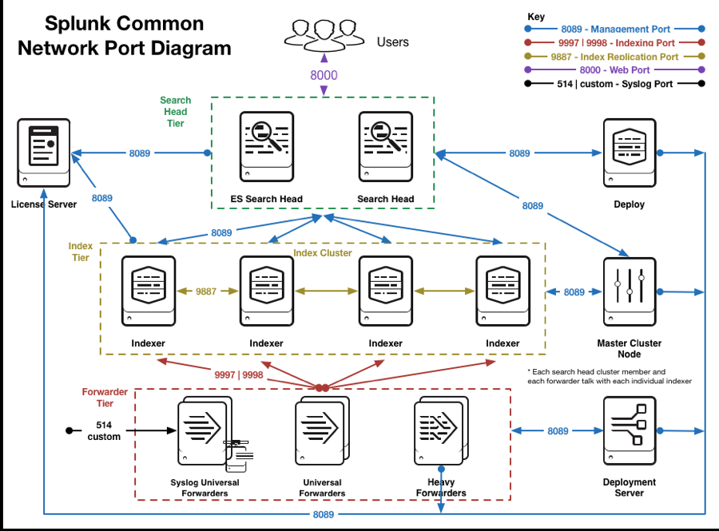
SPLUNK NETWORK DATA FLOW

Slide 19






SPLUNK BENEFITS
03
Searching & Investigation
04
06
01
Monitor Business Metrics
Store & Retrieve Data for Latter Use
Analyze System Performance
02
Troubleshoot any failure
05
Create Dashboards

Slide 20

T H A N K S F O R W A T C H I N G

